Slide 1
C++ Meetup Eindhoven: Writing better C++
Jan Wilmans, Bart van Tongeren, Paul Jansen & Laurens Jansen
27/11/2024
Notes:
Fill in Title
Change name of Presenter and Job Title
Add company name underneath presenter, if applicable
Can you tell something about the kind of software that you are developing?
Can you tell something about your development process (multisite, agile, …)?
Are you suffering any software quality issues?
Are there any software quality constraints/demands?
What kind of quality measures did you already take?

Slide 2



















































Companies
Strong customer base
Over 8,300 projects
More than 1 billion LOC
World-wide customers
Across all domains
Notes:
- How many lines of code do you have? Do you know?

Slide 3
History
Agenda
Talk 1 – Jan Wilmans: C++ Default Guidelines
Talk 2 – Bart van Tongeren: On the use of the C++ Core Guidelines
Short break
Talk 3 – Paul Jansen: Implementing C++ Coding Standards
Panel discussion and questions
Drinks

Slide 4
C++ Default Guidelines

Slide 5
Agenda
Who is Jan Wilmans?
Why yet another set of guidelines?
Defaults > Guidelines
Discussion!
Final tips & takeaways

Slide 6
Software developer
Promexx (12 years)
Bruker / Varian, Scion (Gas Analysis)
Assembléon / K&S (Pick and Place machine)
FEI / ThermoFisher (Electron Microscopes)
C++Coach / Architect
Kind / Vimec / Tiama / Kestrel (5+ years)
open-source contributions:
CMake
Copperspice
https://www.copperspice.com/
DebugView++ https://github.com/CobaltFusion/DebugViewPP
WG21/SG14 (Study group for low latency)
In the process of joining WG21, the ISO C++ Committee.
I was a guest at the last Wrocław (wrot-swav) meeting.
std::guarded<T> https://isocpp.org/files/papers/P3497R0.html
personal website:
nullptr.nl

Slide 7
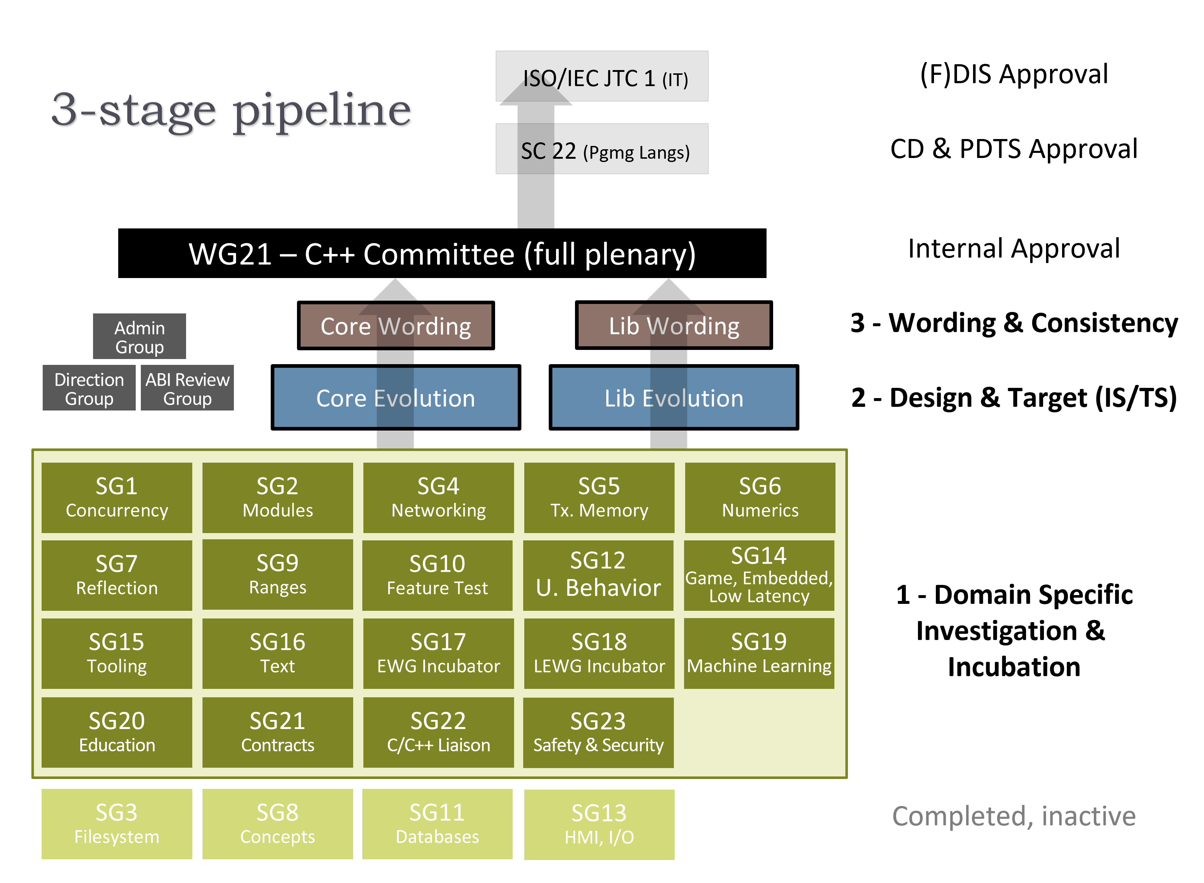


The Committee: WG21 (Working Group 21)

Slide 8

Many C++ Developers are passionate about making code better ... but disagree about what “good code” looks like.
Various reasons for disagreement:
language complexity, flexibility
Support for different paradigms, (functional, OO, procedural)
The last decade: many new features (constexpr, ranges, coroutines, concepts, etc. )

Slide 9
Timeless discussions
(which I will not talk about today)
tabs vs spaces
whitespace
> get rid of it, use a formatter like clang-format, AStyle, Uncrustify
personal preferences, often without rationale.

Slide 10
Why another set of guidelines?
I did not invent new guidelines
I gathered existing material, filtered, simplified and prioritized
The simplification is key
The prioritization gives defaults.
In short:
This approach focuses on making guidelines practical and accessible through simplification and clear prioritization.

Slide 11
GOALS
Understandable Maintainable code
Readability
Local reasoning
Correctness

Slide 12

Highest Level Summary
Turn on warnings! and use sanitizers
Avoid global mutable state
Keep the scope of variables and type declarations as limited as possible
Initialize all variables at declaration
Use const whenever you can
(but no const for member variables and return types)
Use [[nodiscard]] for all const member functions returning a value
Avoid returning values using arguments
Use automatic resource management (RAII)
Follow the rule of 0 or the rule of 5 in that order
Avoid owning raw pointers
Avoid manual memory management using new, delete, malloc, free, etc.
(when working with Qt the use of the new keyword explicitly allowed)
Do not use C-style casts
Do not add member variables to classes used as interfaces. (Interfaces are defined as pure virtual classes that have a virtual = default destructor)
Do not use protected member variables.
Avoid the use of volatile, const_cast, reinterpret_cast, typedef, register, extern, protected or va_arg
Make all destructors of classes used in runtime polymorphism virtual
Avoid references as data members of a class

Slide 13
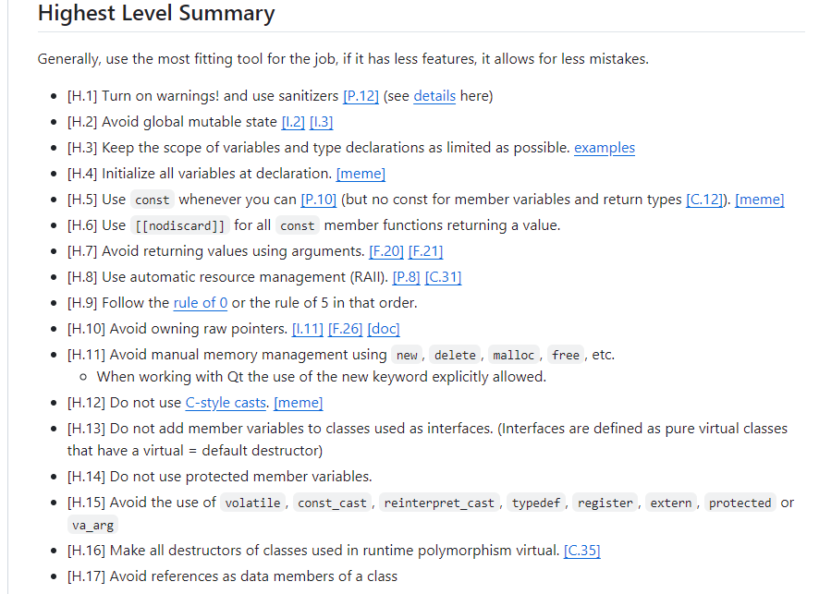

Slide 14
Discuss
What are the most valuable defaults?

Slide 15
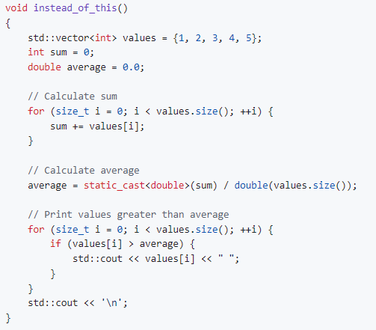

Slide 16
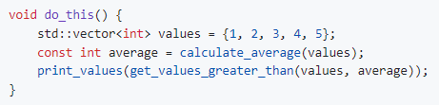

Slide 17
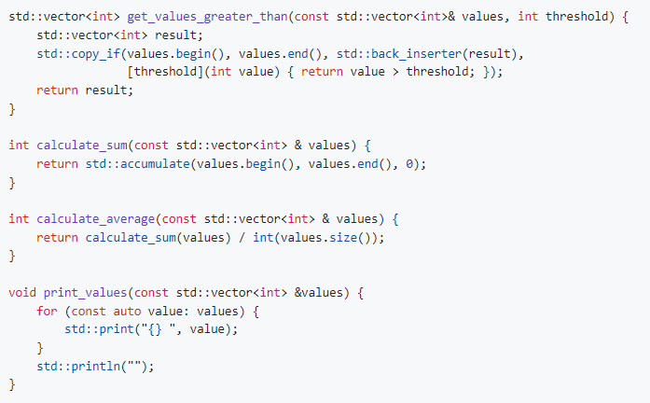

Slide 18
Take-aways
I hope I convinced you that:
defaults are better than just guidelines
shaded defaults are better still

Slide 19
THANK YOU
The Default Guidelines can be found here:
https://github.com/janwilmans/guidelines
Jan Wilmans
website: nullptr.nl
twitter: @janwilmans

Slide 20
On the use of the C++ Core Guidelines
for better software product quality
Bart van Tongeren
software architect at ASML
C++ Meetup Eindhoven @ Tiobe
CREATION DATE: 2024-11-11
D001634204 / 00

Slide 21
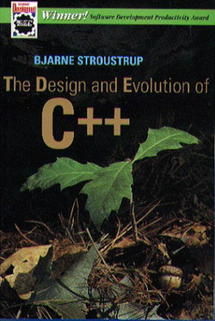
Writing better C++ code
as enabled by the improving C++ itself ?
C++ is getting better itself, ever getting closer to its design goals:
some 45 years ago, starting as ‘C with classes’ – a better C
evolved as a system programming language
supporting multiple paradigms: procedural programming, object-based programming, object-oriented programming, generic programming
supporting concurrency: multi-threading, parallel algorithms, co-routines
supporting large scale programming: namespaces, modules
industrial strength
ISO-standardized in 1998 with regular 3-yearly revisions since 2011
maintaining a high degree of backward compatibility; a C++ program written 40 years ago, may still compile today without much or any effort
C++ is a large and complex language, with some historical quirks.
A programmer can get lost in it - and not effectively use it as ‘modern C++’.
C++’s type system and semantics are much cleaner than its syntax. Within C++, there is a much smaller and cleaner language struggling to get out. (D&E of C++, p 207)

Slide 22


Writing better C++ code
requires understanding C++
To write better C++, it is essential to understand the big picture, i.e., its supported programming paradigms and what they aim to achieve. Understand the major features of the C++ programming language. And finally, go into the details.
There is thus a curious upside-downness to our normal human way of perceiving the world: we are built to perceive “big stuff” rather than “small stuff” (Douglas R. Hofstadter)
Understanding does not come from studying a detailed set of rules.
Understanding comes from studying the concepts and use them in practice.
Learn the concepts and how to use them in modern C++ by, e.g., reading a good book:
for beginning programmers
for experienced programmers

Slide 23
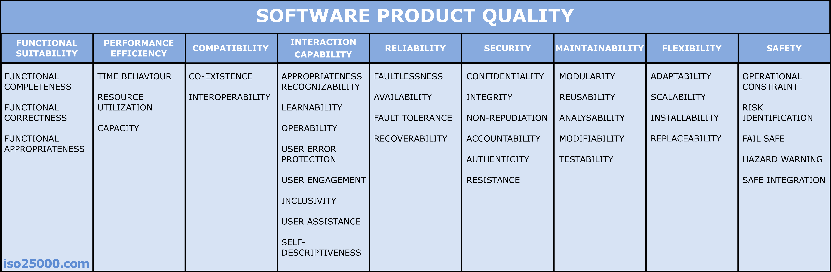
Writing better C++ code
to yield a better software product quality
The ISO 25010:2023 standard specifies a well-defined software product quality model.
It comprises 9 quality characteristics with 40 subcharacteristics, all concisely described at ISO 25010 (iso25000.com).
Several of these quality characteristics will be relevant for your software product at hand. That quality should be reflected by the product’s requirements and design choices.
Poorly written C++ code may affect any of the quality characteristics of the product. How to test the product’s quality?

Slide 24
Software Product Quality
How to test it? 1. Perform static code analysis.
We can do some early checks at development-time:
Static code analysis to detect some constructions that may degrade reliability, security, maintainability, or flexibility.
This includes partly automated checking on compliance to a coding standard.
If passed, the code by itself has some basic sanity.

Slide 25
Software Product Quality
How to test it? 2. Run unit tests and review the code.
We can do more early testing: unit-testing and reviewing the code.
A review is a very powerful kind of test. The reviewers can think of any scenario and how the software would behave. Reviews can cover all relevant quality characteristics. If passed, the code is thought to adhere to its design and requirements.

Slide 26
Software Product Quality
How to test it? 3. Run module and system tests.
Module and system-level tests may cover most quality aspects except maintainability and flexibility – as these are not observable by using the product. Try to check/review those earlier.
While module and system-level are performed when the implementation is done, any issues found may be relatively expensive to fix.

Slide 27
Using a coding standard
Why does it (not) matter?
Coding standard aims are
to prevent coding errors
to prevent coding using obsolete or deprecated language features
to prevent coding using undefined or implementation defined language features
to achieve a certain consistency in style
However, as we have seen:
even full compliance to a coding standard does not ensure software product quality!
not any product quality characteristic can be fully addressed by a coding standard
So, don’t overestimate the importance of a coding standard.
It is very useful to allow focusing attention on the hard parts of developing a high quality software product.
Be aware that a coding standard should not be overly restrictive.
Do not easily forbid common C++ programming idioms, hampering programmers.
Don’t make a new guideline for each problem that ever occurred: this will never finish and result in too many guidelines.
Better invest in learning and training to improve C++ programming craftsmanship.

Slide 28


Using a coding standard
Which one?
As we discussed before, C++ is a large and complex language.
It is offering new and improved core language and library features in each standard revision.
For proper use of this evolving language, make use of authoritative sources of know-how.
At ASML, our C++ coding standard is based on
the Philips C++ coding standard now published by TIOBE, originating from Philips Healthcare (Tongeren, Schaick), which was based on
the book “Industrial Strength C++” (Henricson, Nyquist; 1997), which was a successor of
the public domain Ellemtel C++ coding standard (Henricson, Nyquist; 1992).
Currently, we are in the process of gradually adopting the C++ Core Guidelines, a coding standard under an MIT-style license published by the ISO C++ foundation.
The C++ Core Guidelines were introduced at the CppCon 2015: see slides.
Editors are Stroustrup and Sutter. There are now over 300 contributors.

Slide 29
The C++ Core Guidelines
intro
The modest aim is to “help C++ programmers to write simpler, more efficient, more maintainable code”.
The focus is on ‘modern C++’, currently mentioning C++17/20.
Although named “core guidelines”, it is a sizeable set of guidelines – hundreds of pages if in print format.
The guidelines do refer to sources like
the several “Effective C++” books by Scott Meyers,
the “101 C++ Coding Standards” by Sutter and Alexandrescu, and
Stroustrup’s “A Tour of C++”, and others.
The advices summarized at the end of each chapter of Stroustrup’s books started the C++ Core Guidelines.

Slide 30
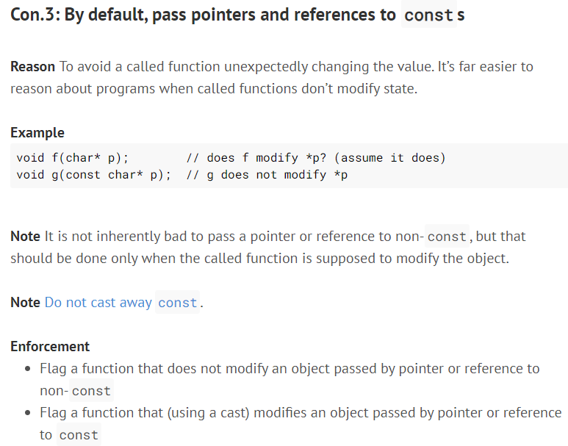
The C++ Core Guidelines
an example of a simple guideline

Slide 31
The C++ Core Guidelines
structure and alignment with standard C++ revisions
The guidelines are organized in sections. The sections are not orthogonal.
E.g. the Functions section is not the only section with guidelines on functions. The interface section has something to say on the number of function arguments, and the Classes section has a guideline on lambda functions vs function objects.
The enforcement of a guideline may just be a hint to the reviewer rather than a precise specification for an automatic check by a tool.
The guidelines do not attempt to subset the language. Instead, they are designed according to the so-called “subset of superset” principle.
The Guideline Support Library (GSL) provides some extensions that can be used to avoid the use of error-prone C++ features.
Parts of the GSL already have been standardized.
In: Introduction
P: Philosophy
I: Interfaces
F: Functions
C: Classes and class hierarchies
Enum: Enumerations
R: Resource management
ES: Expressions and statements
Per: Performance
CP: Concurrency and parallelism
E: Error handling
Con: Constants and immutability
T: Templates and generic programming
CPL: C-style programming
SF: Source files
SL: The Standard Library

Slide 32
The C++ Core Guidelines
profiles and company-specific extensions
A profile names a group of related rules. A rule can be part of several profiles, or none.
Current profiles are:
type: No type violations (reinterpreting a T as a U through casts, unions, or varargs)
bounds: No bounds violations (accessing beyond the range of an array)
lifetime: No leaks (failing to delete or multiple delete) and no access to invalid objects (dereferencing nullptr, using a dangling reference).
If a rule is labeled with a profile, that helps the reader to find related rules.
The C++ Core Guidelines can be extended by large organizations, large projects, or for specific application areas.
e.g. guidelines on the use of specific libraries for memory management or error handling.
try to avoid to (locally) redefine the core guidelines; only do that by submitting a defect report.

Slide 33
The C++ Core Guidelines
keeping up
The C++ Core Guidelines are a continuous work in progress, keeping up with the C++ revisions and fixing issues.
You can subscribe to a mailing list to be notified on changes.
The guidelines are many, but also still incomplete - as if it is a version 0.8. Problems are acknowledged:
The sets of rules have not been completely checked for completeness, consistency, or enforceability.
Triple question marks (???) mark known missing information
Update reference sections; many pre-C++11 sources are too old.
The guidelines do not yet cover C++20, while C++23 is already out. Not a huge problem, as most companies are not yet using C++20/23 anyways.
The guidelines hardly keep up with the standardization of new C++ revisions, which is fortunate and unfortunate …
The guidelines were initially created with contributions from experts at CERN, Microsoft, Morgan Stanley, and several other organizations. Contributions are welcome. As Stroustrup said in his announcement: “We need help!”

Slide 34
Bart van Tongeren
HTC - Eindhoven
software architect
email
bart.van.tongeren@asml.com

Slide 35
Break
Short break of 15 minutes!

Slide 36
C++ Meetup Implementing Coding Standards
Paul Jansen
27-Nov-2024
Notes:
Fill in Title
Change name of Presenter and Job Title
Add company name underneath presenter, if applicable
Can you tell something about the kind of software that you are developing?
Can you tell something about your development process (multisite, agile, …)?
Are you suffering any software quality issues?
Are there any software quality constraints/demands?
What kind of quality measures did you already take?

Slide 37

Paul Jansen
Introduction of myself
Graduated in philosophy and computer science
Founder and CEO of TIOBE Software
Researching programming languages: TIOBE Index
Researching software quality: TIOBE Quality Indicator
Hobbies: geocaching, tennis, Runescape
Married: 2 children

Slide 38
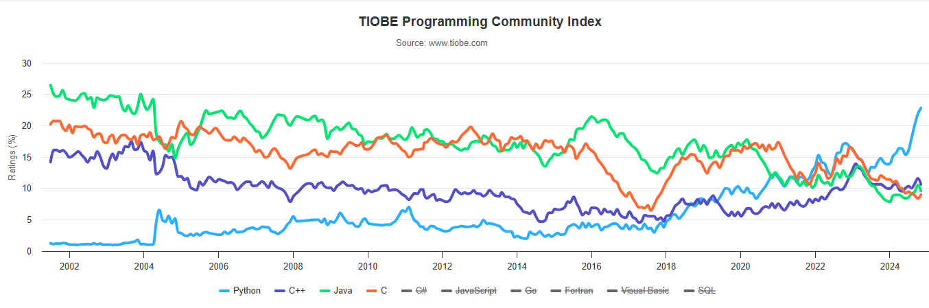
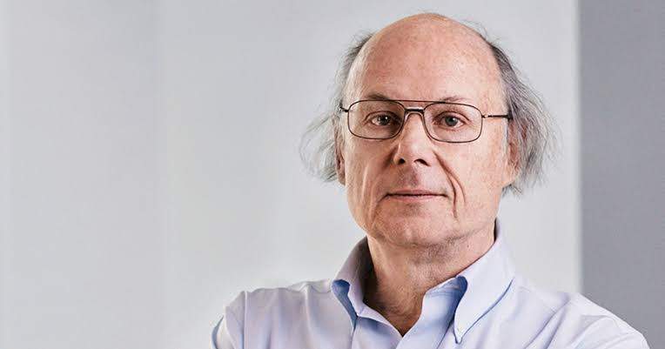
TIOBE Index
Decibel
Bjarne Stroustrup: "The TIOBE index basically measures noise and ought to report their findings in decibel rather than popularity."

Slide 39
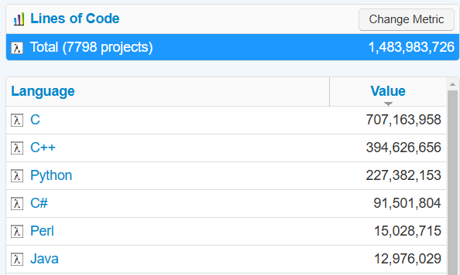
Customer base
Checking ISO25010 code quality
Over 8,300 industrial projects
1.5 billion LOCs each day
World-wide customers
Across all domains
Notes:
- How many lines of code do you have? Do you know?

Slide 40
Overview
Overview
How to design a C++ coding standard rule (implementation) properly?
What tools could you use to check a C++ coding standard?
What pitfalls should you avoid when introducing C++ coding standards?

Slide 41
Axiom 1
Axiom 1:
If you don't implement your coding standards they will not be followed
Notes:
- Do you require specific certification?

Slide 42
Axiom 2
Axiom 2:
Implementing
coding standards comes with great responsibility
Notes:
- Do you require specific certification?

Slide 43

Balancing coding standards rules
Benefits
Avoiding programming mistakes
Educating programmers
Producing maintainable code
Investments
Costs of fixing violations
Costs of running tools
Costs of implementing rules
Costs of false positives

Slide 44


Compiler warning
Fixes for “unused parameters”
Disable the compiler warning
Use “x;”
Use “(void) x;”
Use “DISCARD(x)” or similar
Use “int foo(int) {”
virtual int foo(int x) {
return 42;
}
Notes:
- Do you require specific certification?

Slide 45
Rule “Don’t use multiple returns in a function”
Instead “don’t return in deep state”
int foo(int x) {
if (problem1) {
return 1;
… (the real code)
if (…) {
if (…) {
for (…) {
if (…) {
return 42;
int foo(int x) {
int result = 0;
if (problem1) {
result = 1;
else if (problem2) {
result = 2;
else {
… (the real code)
}
return result;
}
Notes:
- Do you require specific certification?

Slide 46
Rule “Use braces for control statements”
What is wrong with:
if (foo > 0) foo = 0;
if (bar < 42)
bar = 42;
next statement;
We try to prevent:
if (foo > 0);
if (foo > 0) foo = 0; bar = 42;
if (bar < 42)
foo = 0;
bar = 42;
Notes:
- Do you require specific certification?

Slide 47
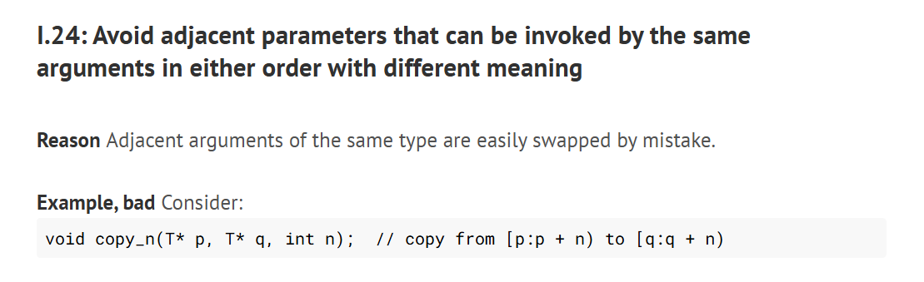
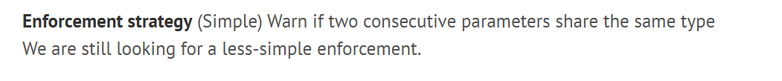
Example C++ Core Guideline rule
Notes:
- Do you require specific certification?

Slide 48
Implementing C++ Core Guideline I.24
Check for the following pattern:
int foo(int height, int width);
foo(m_width, m_height);
Notes:
- Do you require specific certification?

Slide 49
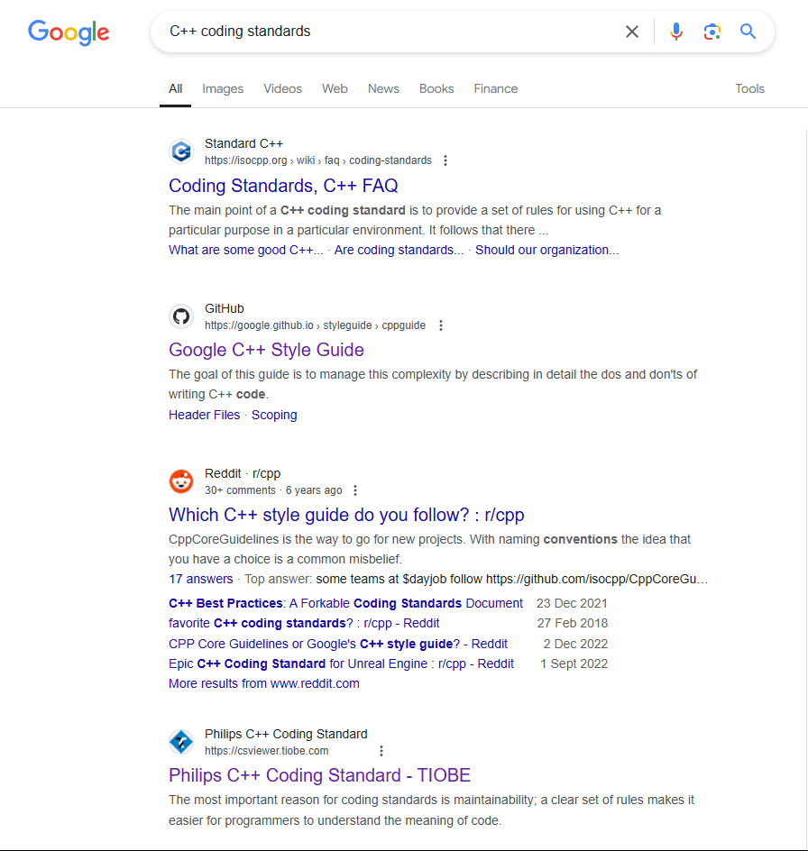
C++ Coding Standards
Available C++ coding standards:
MISRA-C++
Google C++ Style Guide
C++ Core Guidelines
Philips C++ Coding Standard
Notes:
- Do you require specific certification?

Slide 50

The consequences of MISRA-C++ (yesterday on Linkedin)
Notes:
- Do you require specific certification?

Slide 51
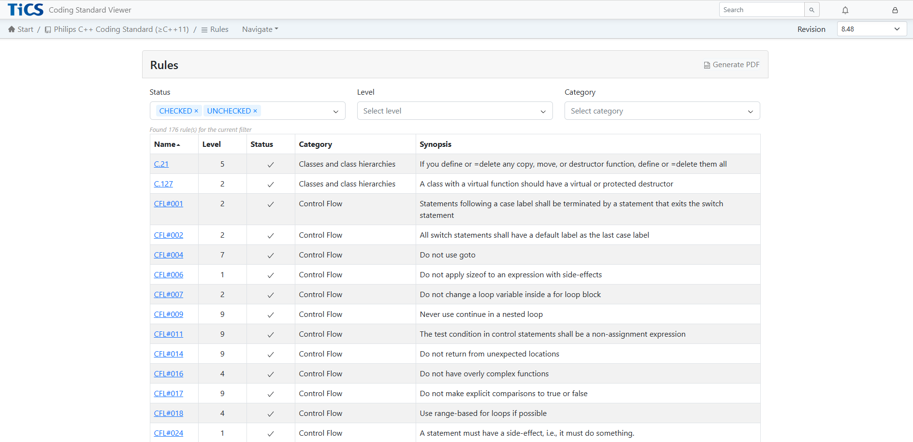
TIOBE’s choice
TIOBE has adopted the Philips C++ Coding Standards
It is based on a selection of C++ Core Guidelines
Combined with common sense rules
It is fit for industrial use
Adjusted once a month
Used by almost all TIOBE C++ customers
Available on www.tiobe.com
Notes:
- Do you require specific certification?

Slide 52
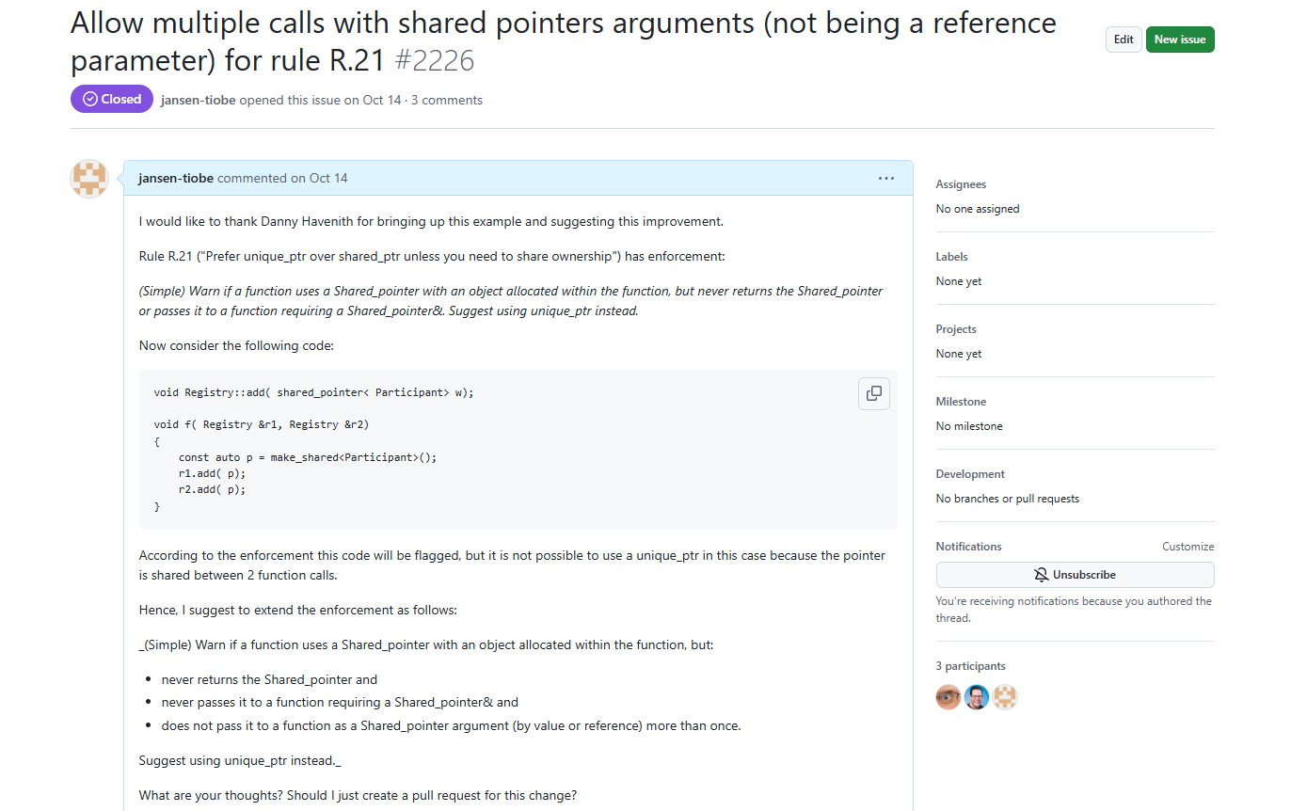
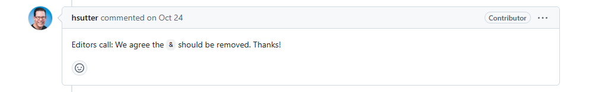
Changes are enforced!
Notes:
- Do you require specific certification?

Slide 53






Company Code Quality Levels
6. Full company quality
Field defects are direct input to code quality changes
5. Company standards
Standards and quality targets are defined at company level
4. Quality gating
Deliveries are blocked if quality targets are not met
3. End user involvement
Software engineers look at the results and take actions
2. Continuous monitoring
Code quality checks are part of the CI/CD process
1. Ad hoc measurement
Having successfully measured code quality at least once
Notes:
Where do you think you are in this model?
What is the next step in your journey according to you?

Slide 54
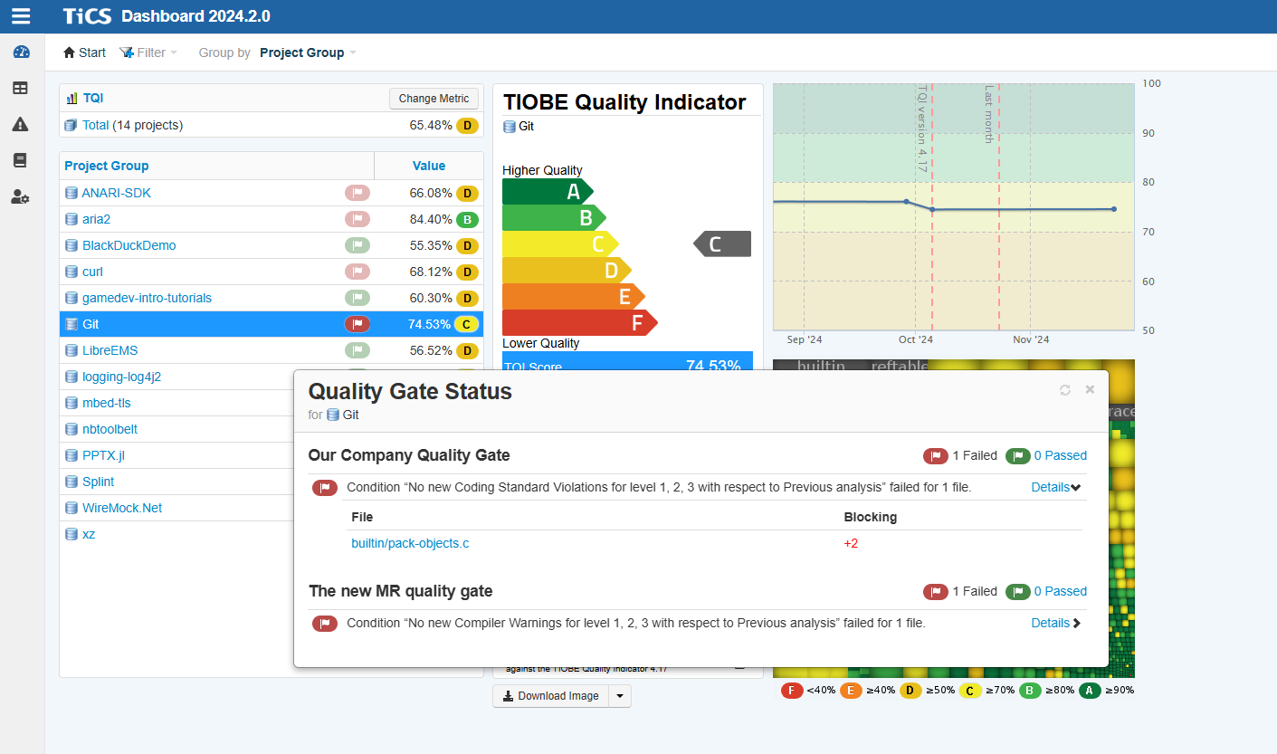
Quality Gates
Notes:
Do you know the ISO 25010?
If so, do you use it in some way?

Slide 55
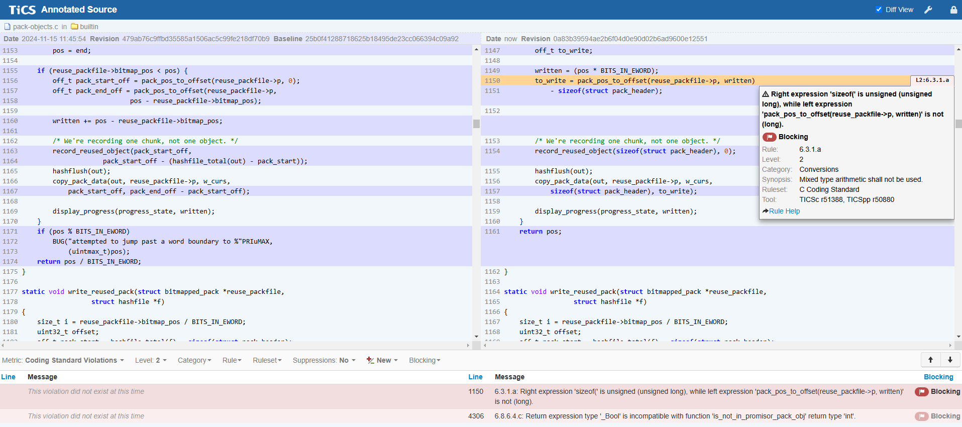
Quality Gates
Notes:
Do you know the ISO 25010?
If so, do you use it in some way?

Slide 56
Axiom 3
Axiom 3:
The best quality target is
"no new coding standard violations of severity levels 1, 2 and 3"
Notes:
- Do you require specific certification?

Slide 57
Axiom 4
Axiom 4:
Only use coding standard rules for quality gates that are fast to check, easy to fix and have no false positives
Notes:
- Do you require specific certification?

Slide 58
Axiom 5
Axiom 5:
Have a fast waiver process in place, both technical and organizational
Notes:
- Do you require specific certification?

Slide 59
Quality gate coding standards
When introducing new coding standards in quality gating:
Be careful, know your responsibility
Test thoroughly in staging environment
Evaluate and be critical
Have a soak time/grace period in place
Notes:
- Do you require specific certification?

Slide 60
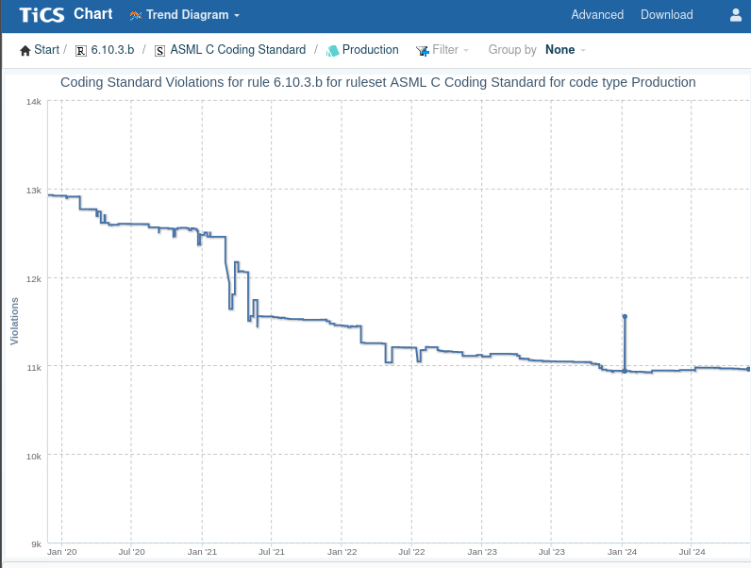
Conclusions
Implementing coding standards:
To do it right is not easy
But if you manage to do it right …
… then wowowow you can celebrate!
Notes:
- Do you require specific certification?

